Slide 1

Secure vault web application project
SWE210 Software Security

Slide 2

Group members:
Iyad Kabel - 2409115130
Y.H.Y.M Bakr Raiyan - 2309116473
Serhat Karasu - 2109111050

Slide 3

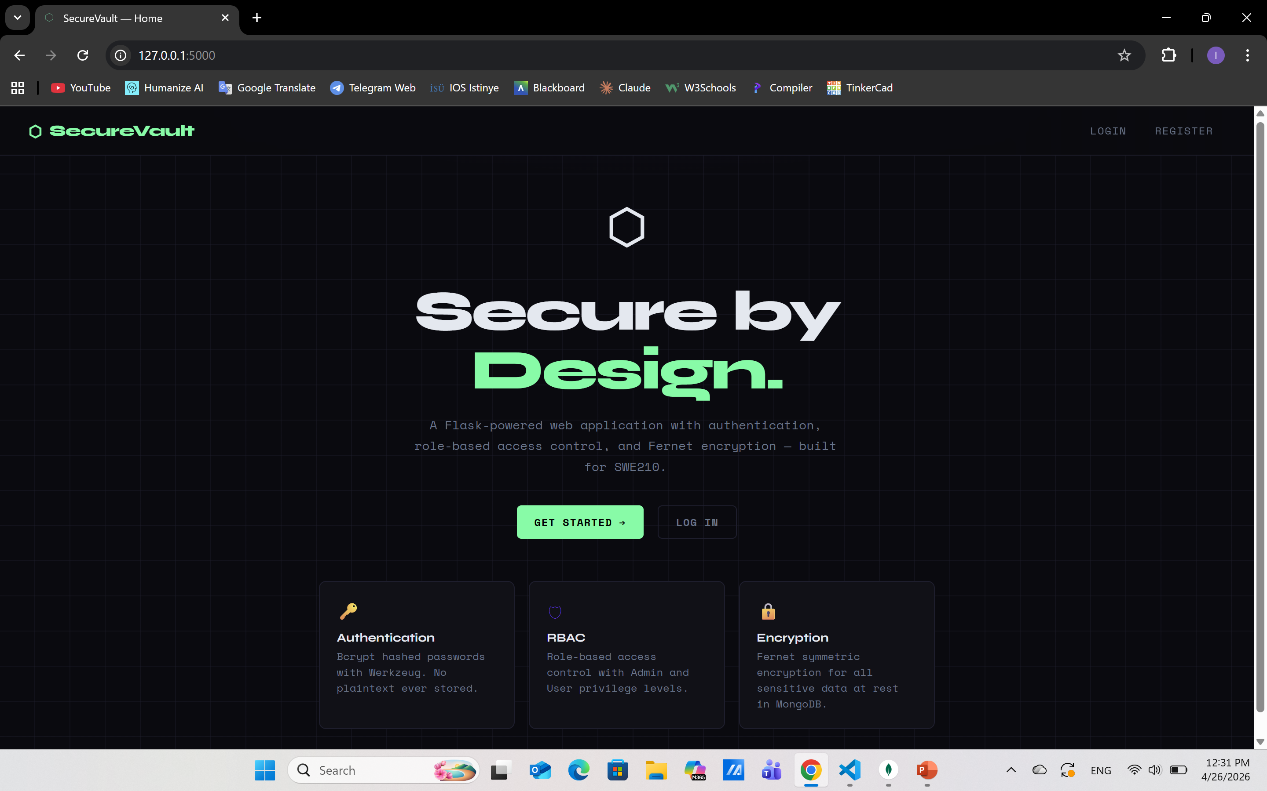
description
SecureVault is a web application secured with the use of Python Flask and MongoDB as part of the group project assigned to the SWE210 Software Security course offered at İstinye University. SecureVault incorporates three main aspects of software security. These include Authentication in which users’ passwords are encrypted with the help of the Bcrypt library, meaning that user passwords are not saved in plain text but rather securely hashed in the application’s database. In addition, the application implements the concept of Role-Based Access Control or RBAC in which users are either Admin or Users depending on their access to specific pages. Lastly, the use of AES-128 cipher called Fernet encryption protects sensitive information by securing data prior to storage in the database.

Slide 4
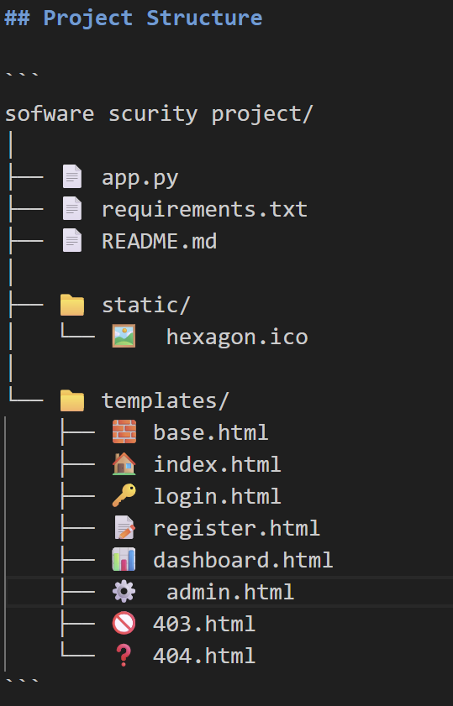
objective
Purpose
This implementation highlights three essential concepts of cybersecurity:
🔑Authentication
Users are able to create accounts and authenticate their identity safely. No passwords are stored in plain text — all passwords are first hashed using Bcrypt through the Werkzeug package and then stored in the database.
🛡️Role-Based Access Control (RBAC)
The program features two roles: Admin and User. Users have limited permissions and can only view their personal dashboard, whereas admins can access an administrative control panel which allows them to promote, demote, or remove other users.
🔒Encryption
Notes are encrypted with Fernet (AES-128) from the cryptography package and saved in MongoDB. Data is decrypted at the time of displaying only for the intended recipient, ensuring that any breach of the database will not allow attackers to read the sensitive data (notes).

Slide 5
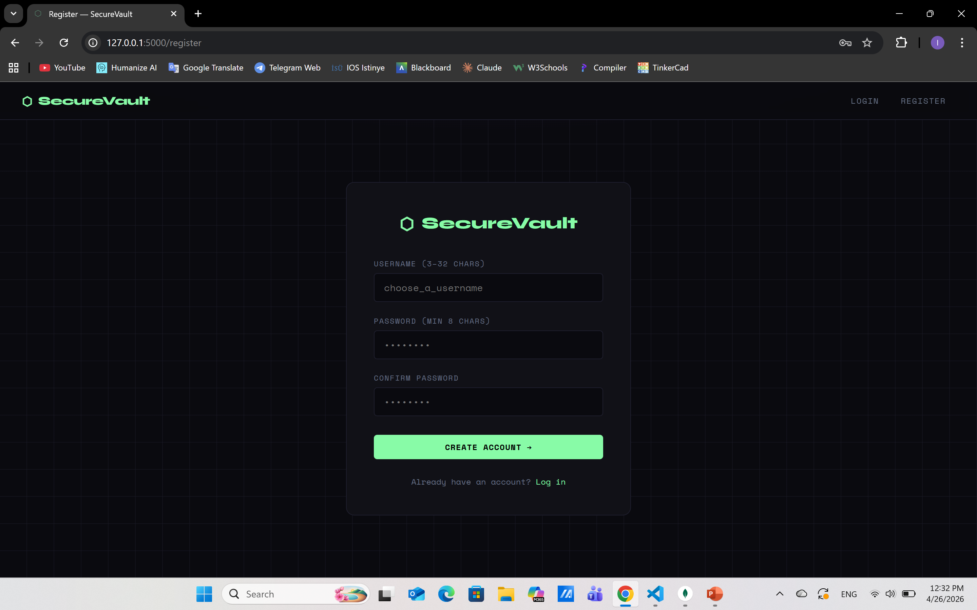
Implemented features
The application implements the following features:
User registration - Users can sign up for the app through their usernames and passwords. The passwords are hashed using Bcrypt and then stored in MongoDB.
User login/logout – Users are able to log in and out securely via sessions in Flask.
Role Based Access Control (RBAC) – There are two types of roles: Admin and User. Some pages have restrictions depending on the role of the user.
Admin panel - The admin is provided with a special dashboard from where he/she can view all the registered users, elevate users to admin status, reduce admins to ordinary users, and delete any particular user.
Note Encryption – Users can encrypt some sensitive data in notes using Fernet (AES-128), save those encrypted notes in MongoDB, and decrypt them when required.

Slide 6
Implemented features
The application implements the following features:
Delete Notes – Users are able to delete their personal notes from the dashboard.
Access Restriction – Protected routes utilize decorators such as @login_required, @admin_required to restrict access and show a 403 page if the user isn’t authorized.
Input Verification – All input by users is verified in terms of required fields and length before processing.
Error Pages – Personalized 403 (Access Denied) and 404 (Page Not Found) error pages are shown on invalid requests.
Flask Session Security – Flask sessions are signed by a secret key that prevents manipulation.

Slide 7
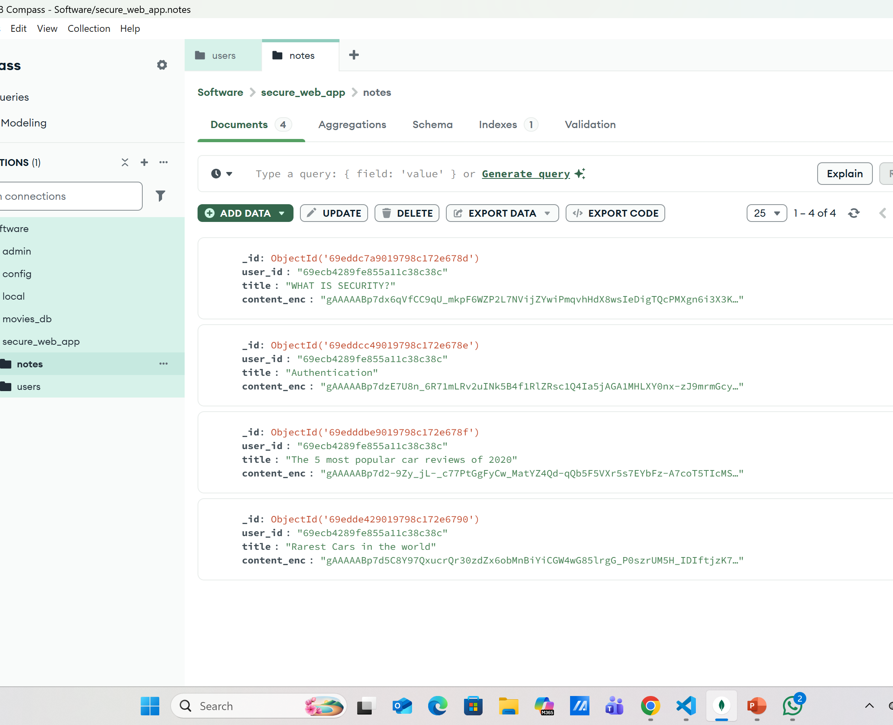
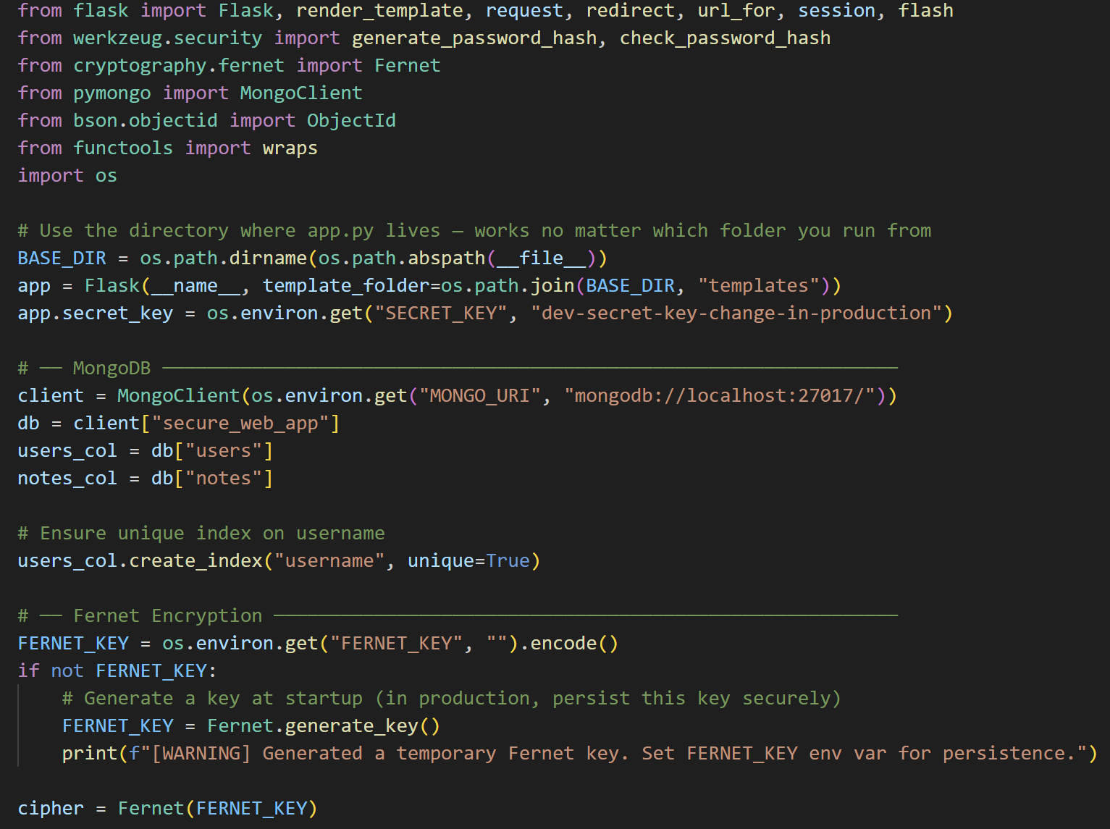
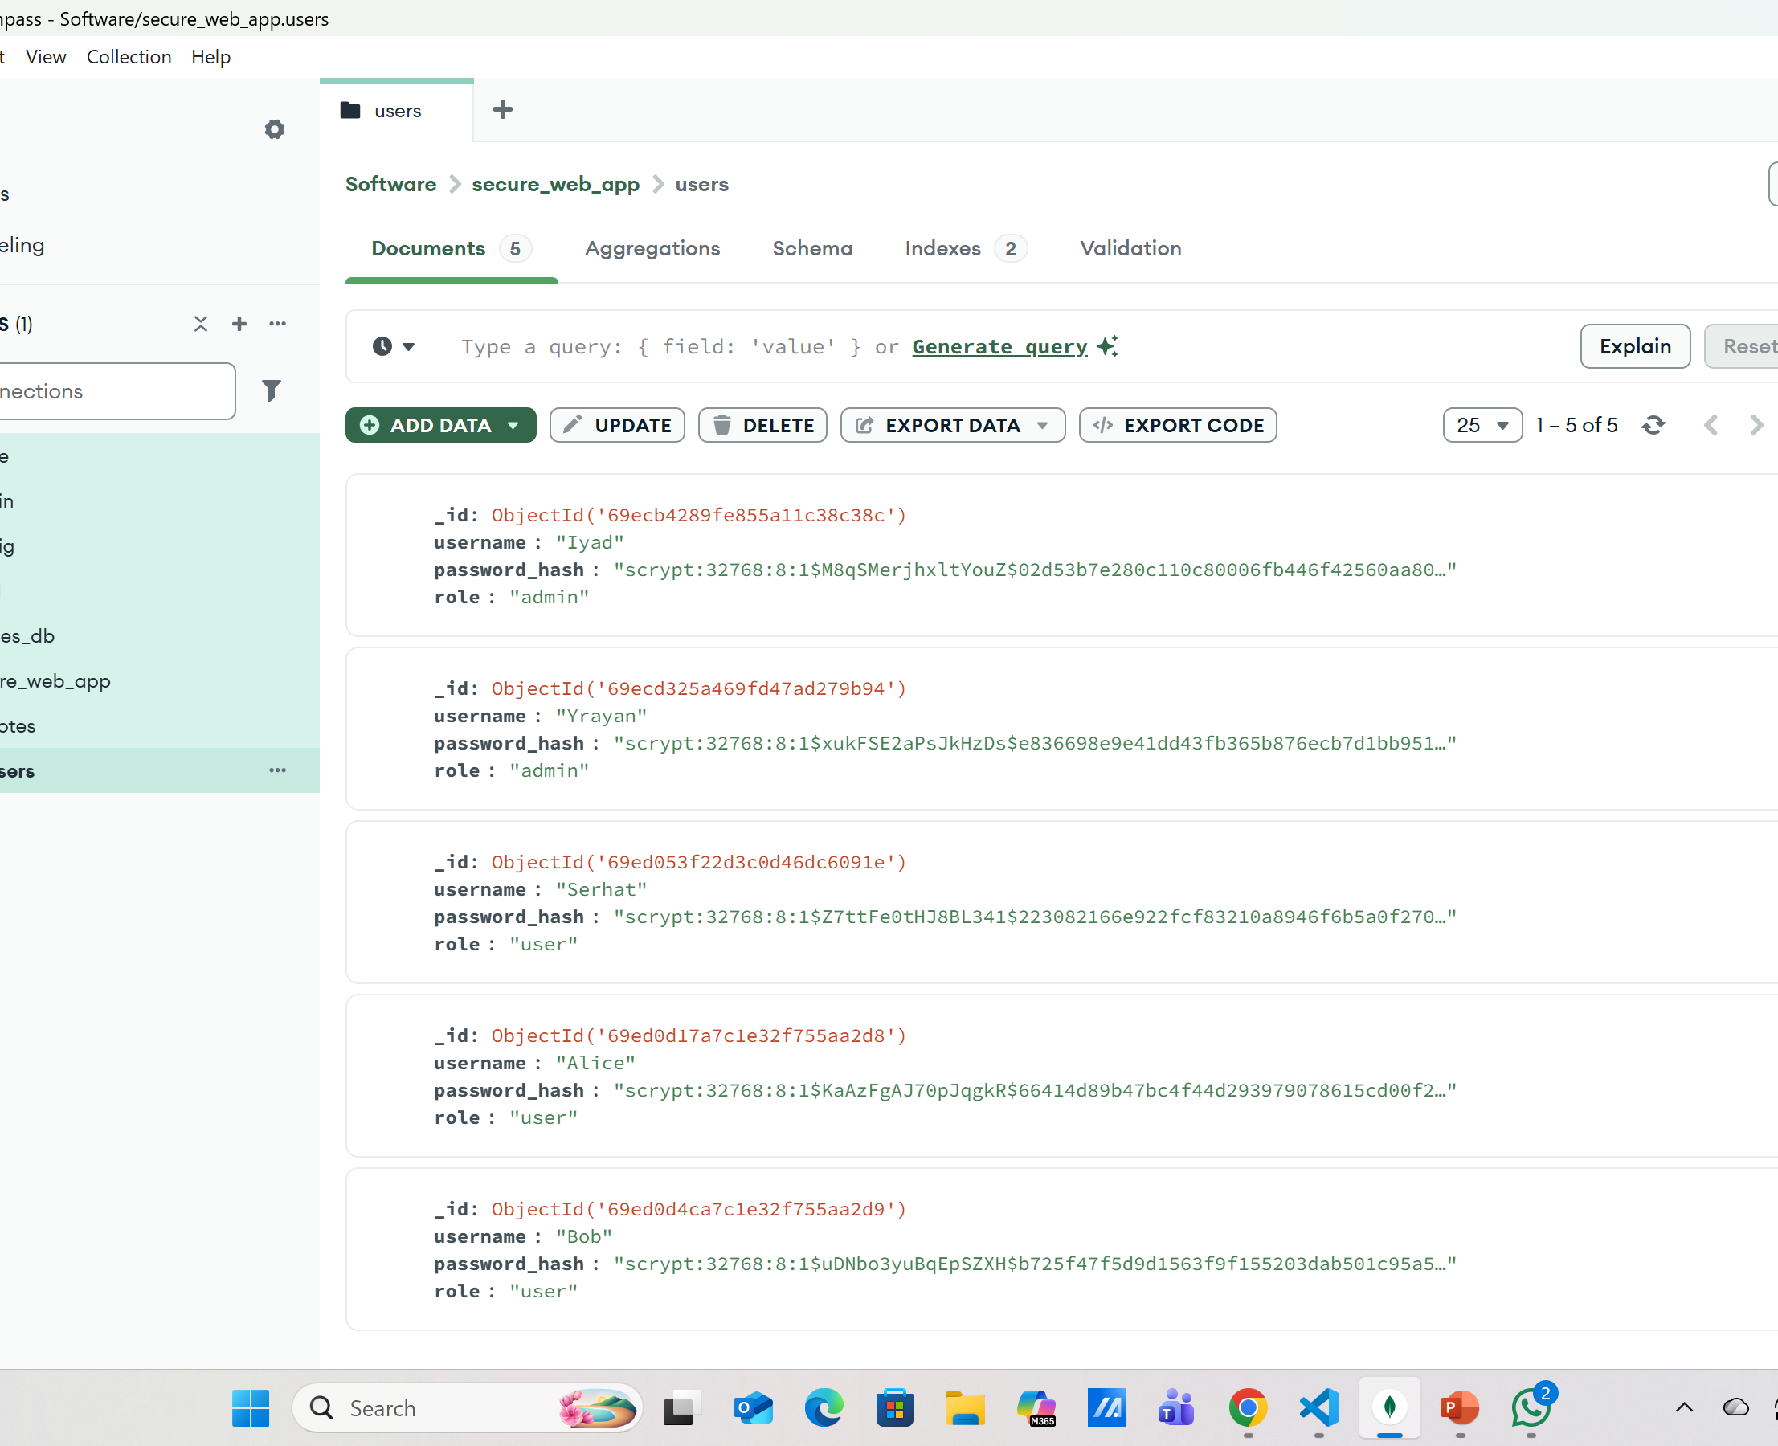
Mongodb database

Slide 8
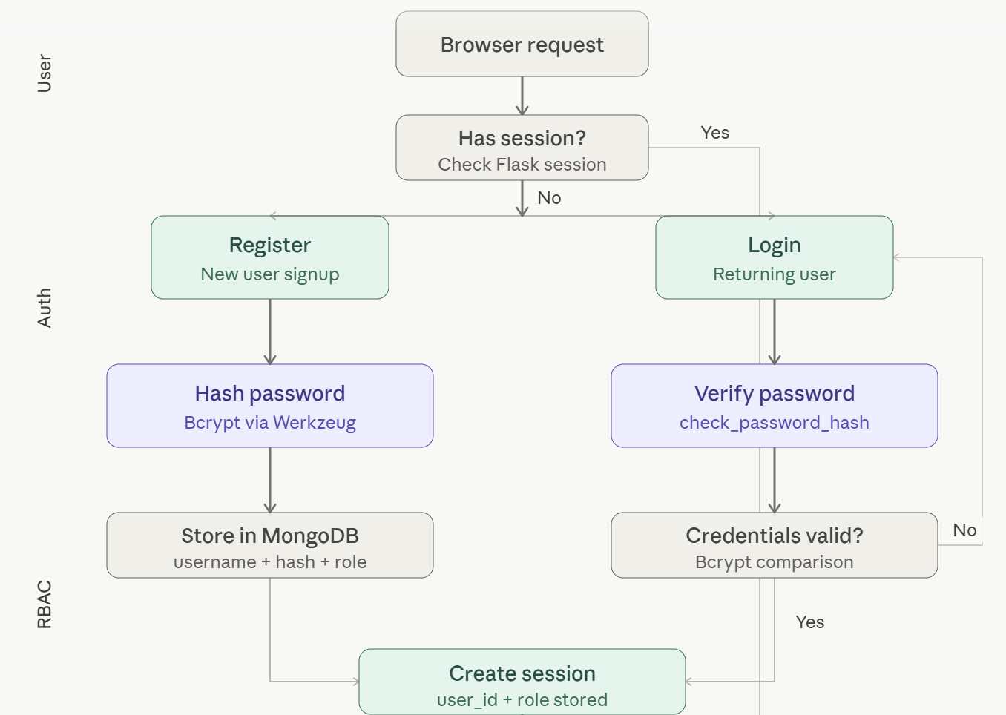
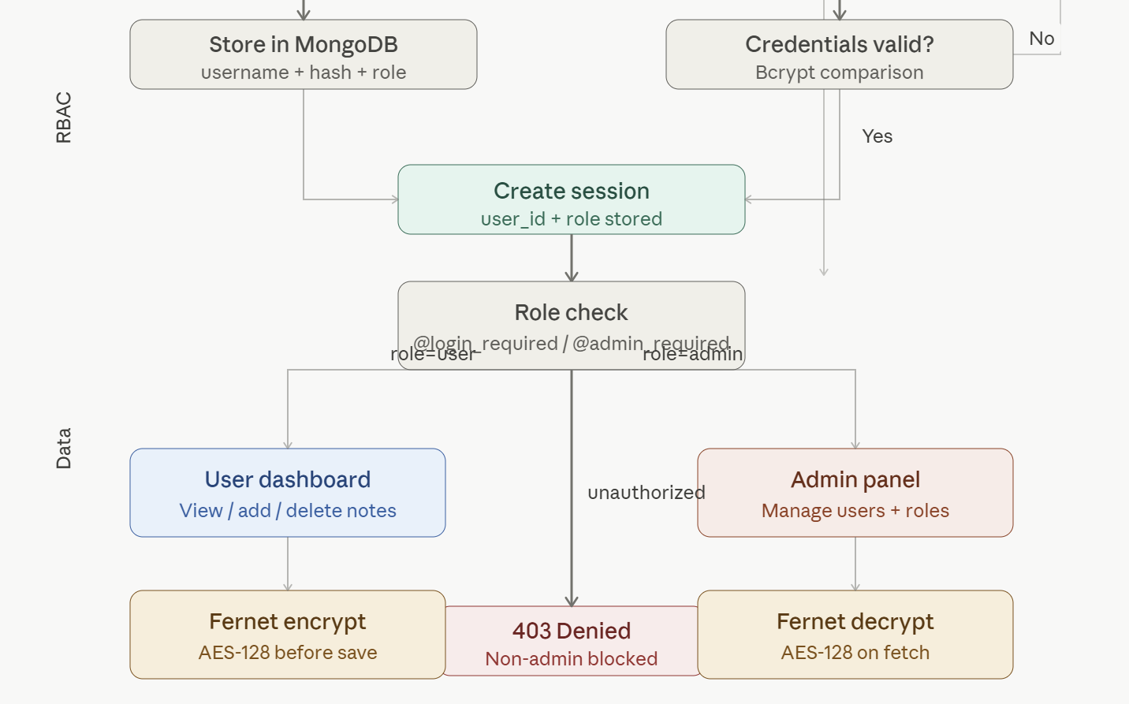
Architecture or flow

Slide 9

Login System
Handles registration and login. Passwords are hashed with Bcrypt and stored in MongoDB. On login, the hash is verified and a signed session cookie is created. Logout clears the session entirely.

Slide 10
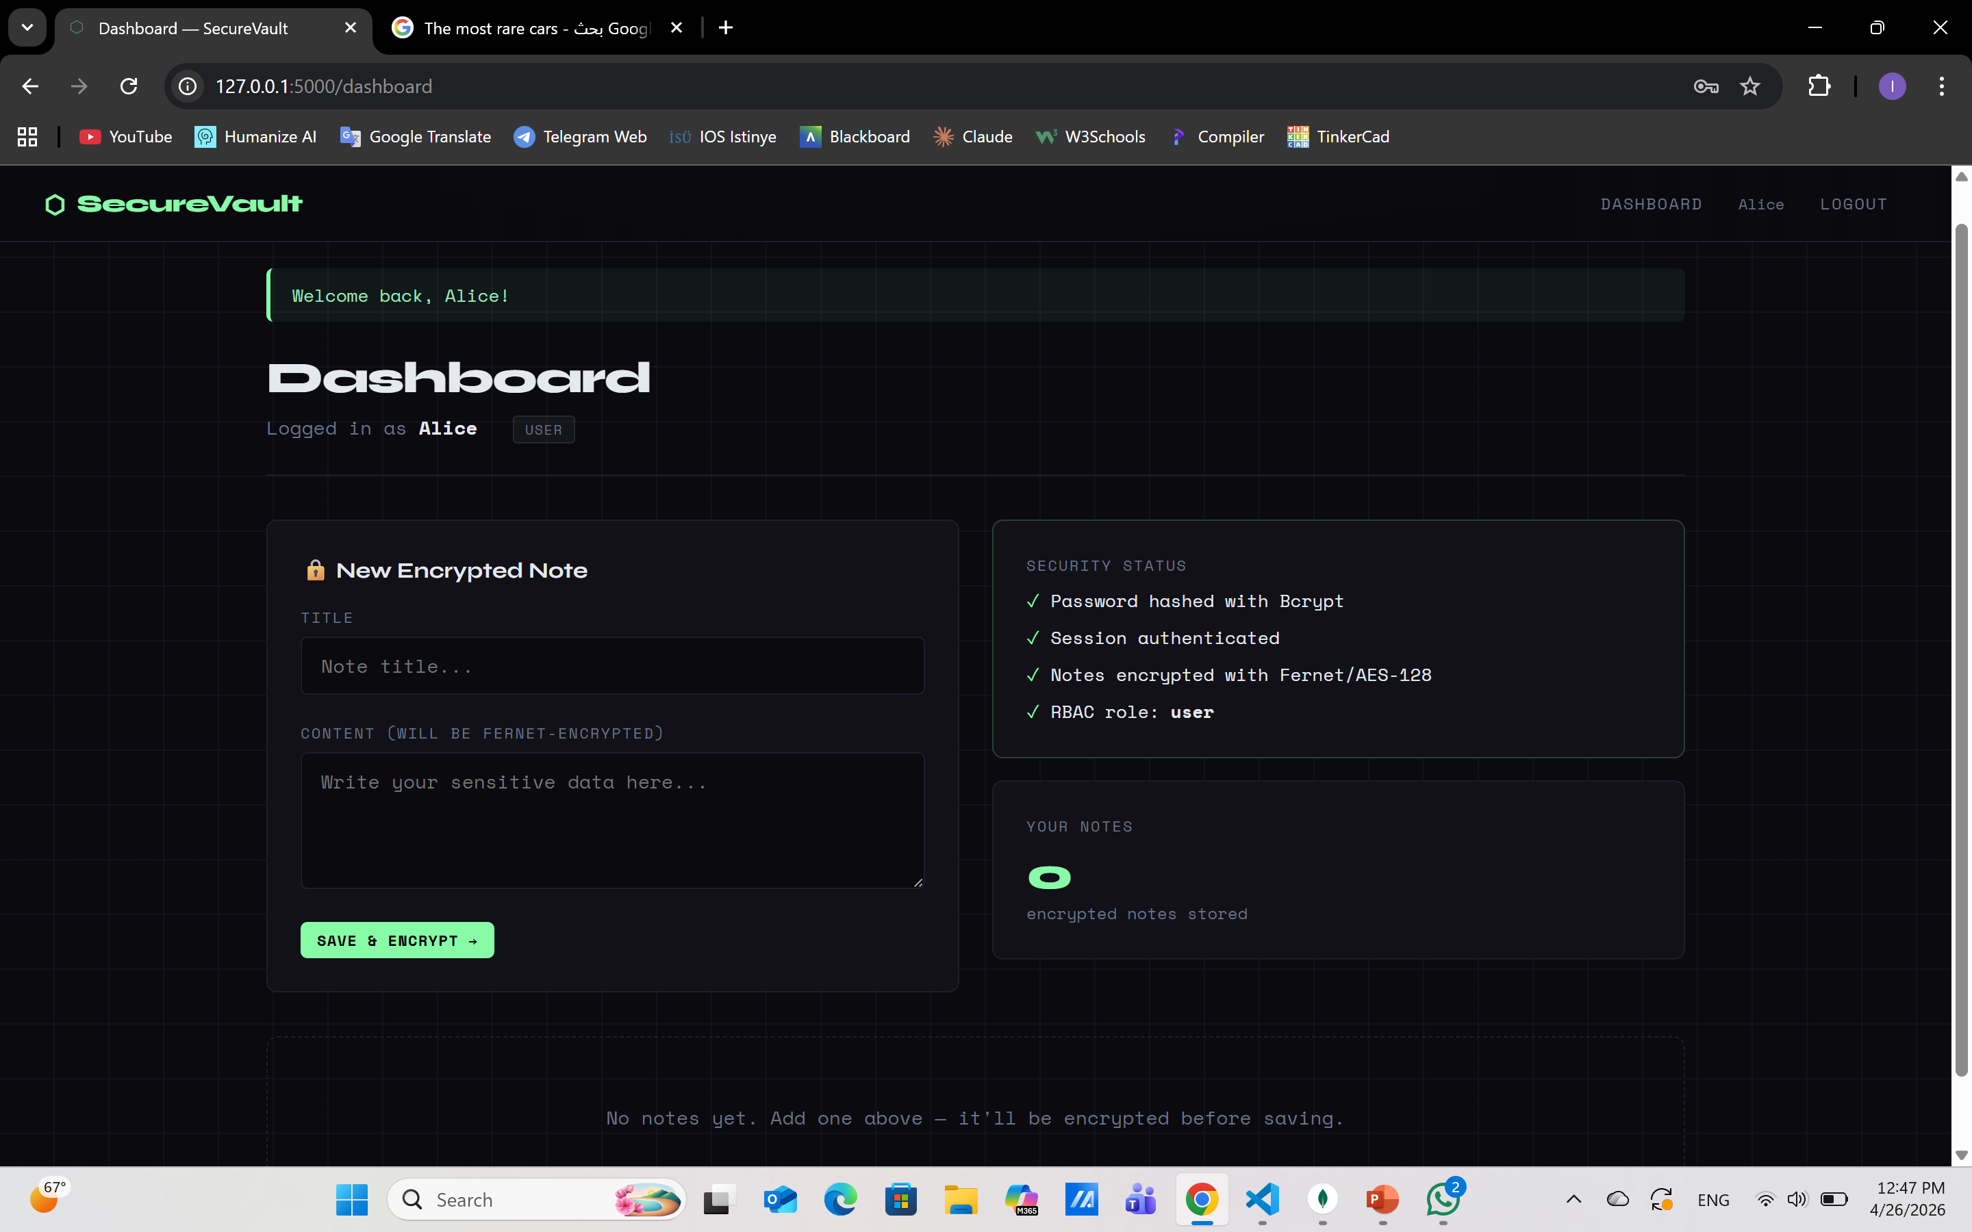
Dashboard
The user's main workspace. Displays personal notes that are decrypted on-the-fly using Fernet. Users can add new notes (encrypted before saving) and delete existing ones.

Slide 11
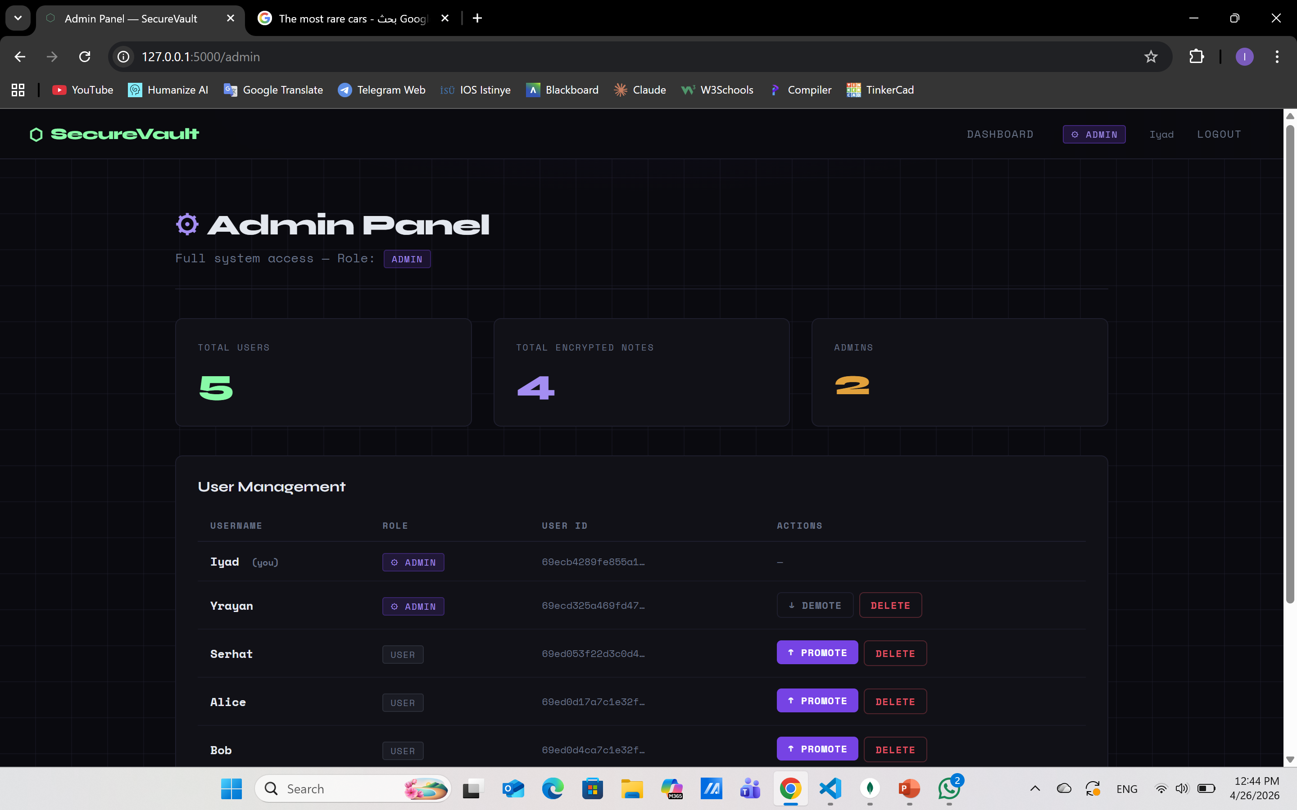
Admin Access
Admins have a dedicated panel to view all users, promote/demote roles, and delete accounts. Access is protected by the @admin_required decorator which blocks non-admins with a 403 error.

Slide 12
login
User submits credentials → app fetches record from MongoDB → check_password_hash compares input to stored hash → if matched, session is created → user is redirected to dashboard.

Slide 13
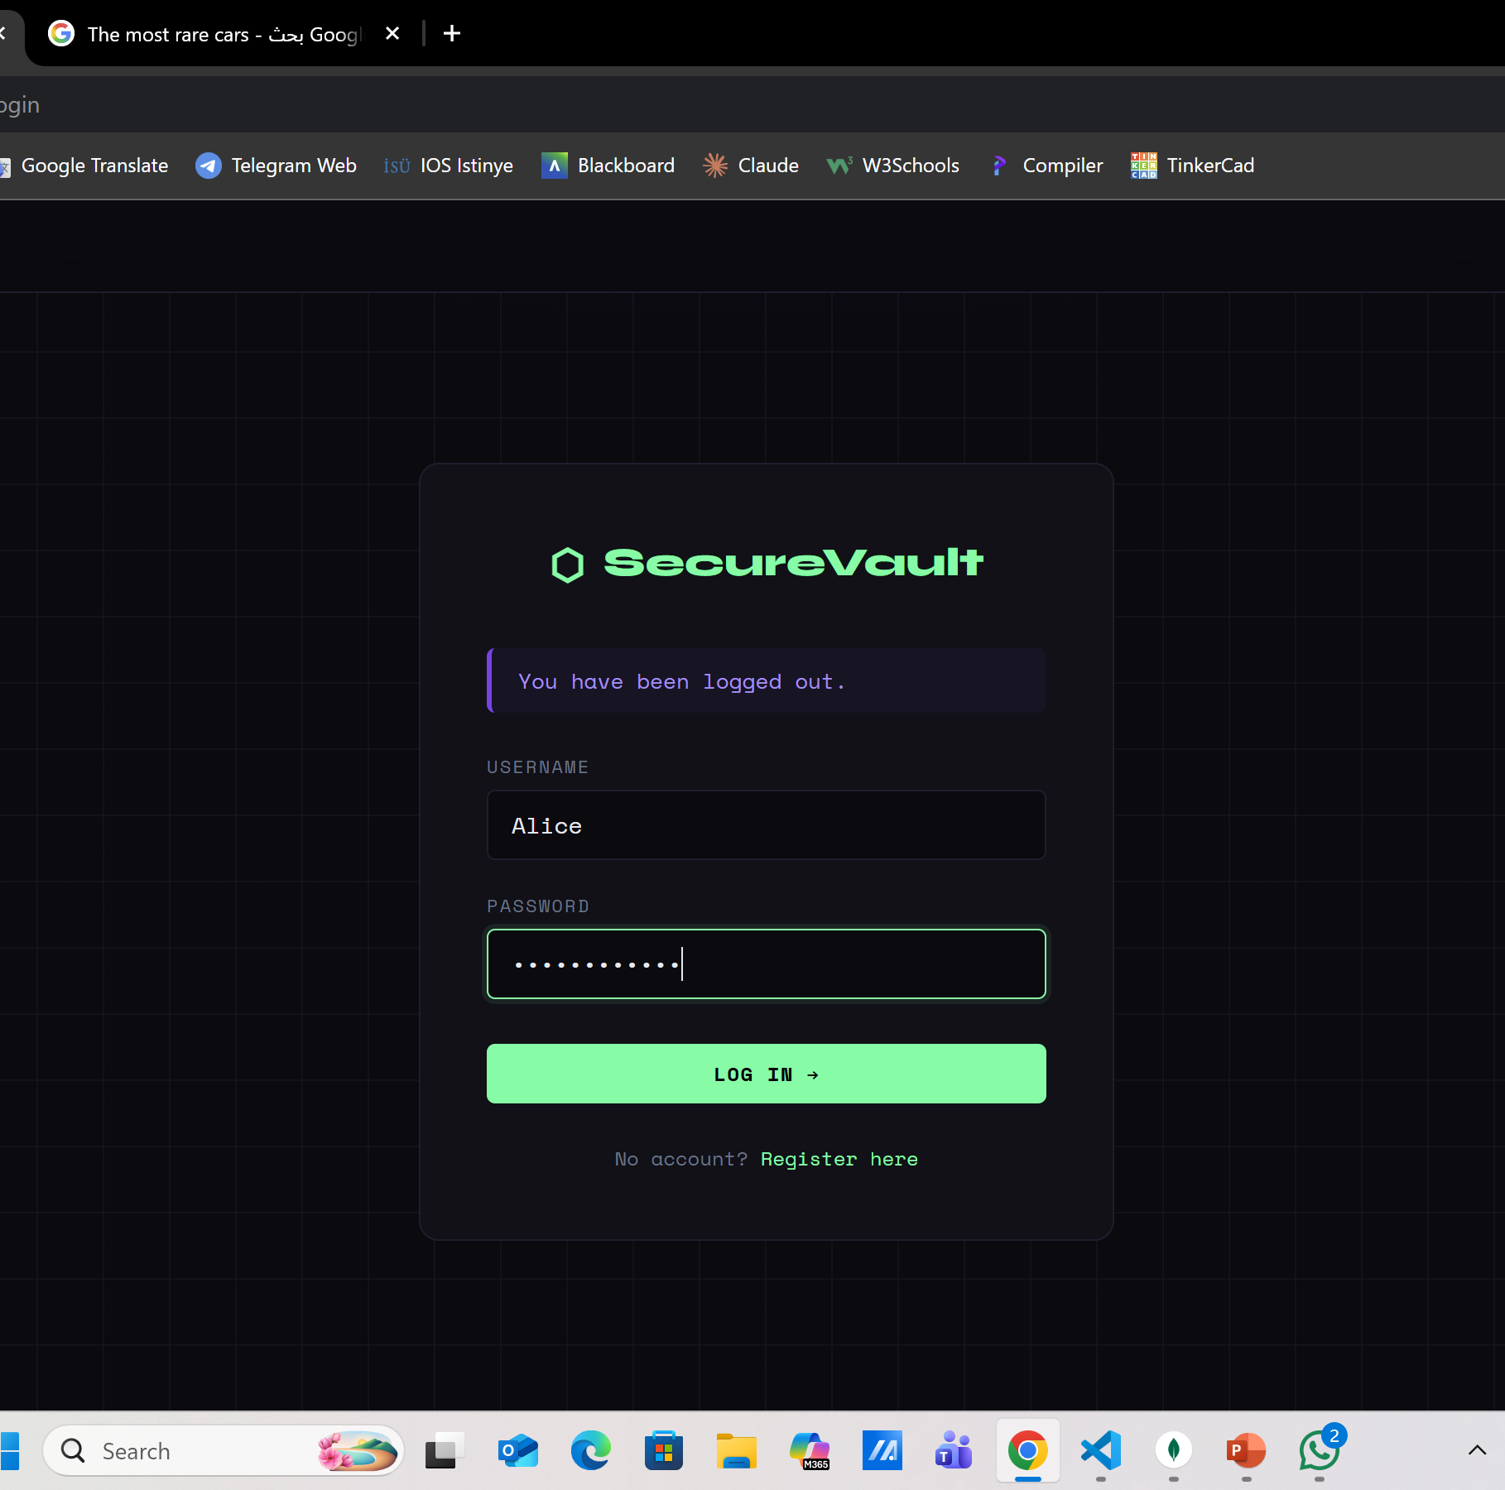
Password hashing algorithm
Password hashing algorithm Bcrypt via Werkzeug’s generate_password_hash / check_password_hash .
Why hashing instead of plaintext?
If the database is breached, hashed passwords cannot be reversed. Plaintext storage means instant exposure of all user credentials.

Slide 14
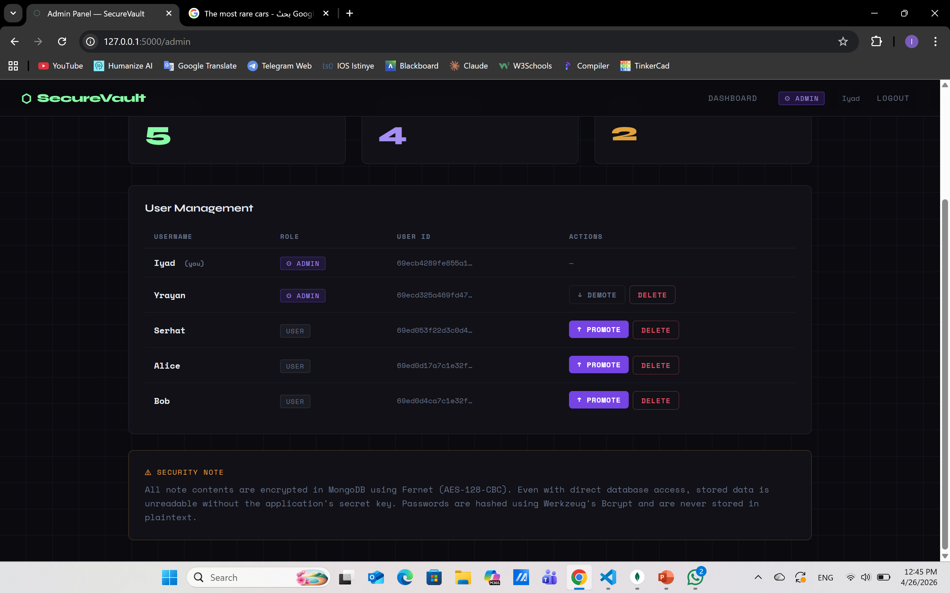
roles
User — default role, can only access their own dashboard and notes.
Admin — elevated role, can access the admin panel and manage all users.

Slide 15
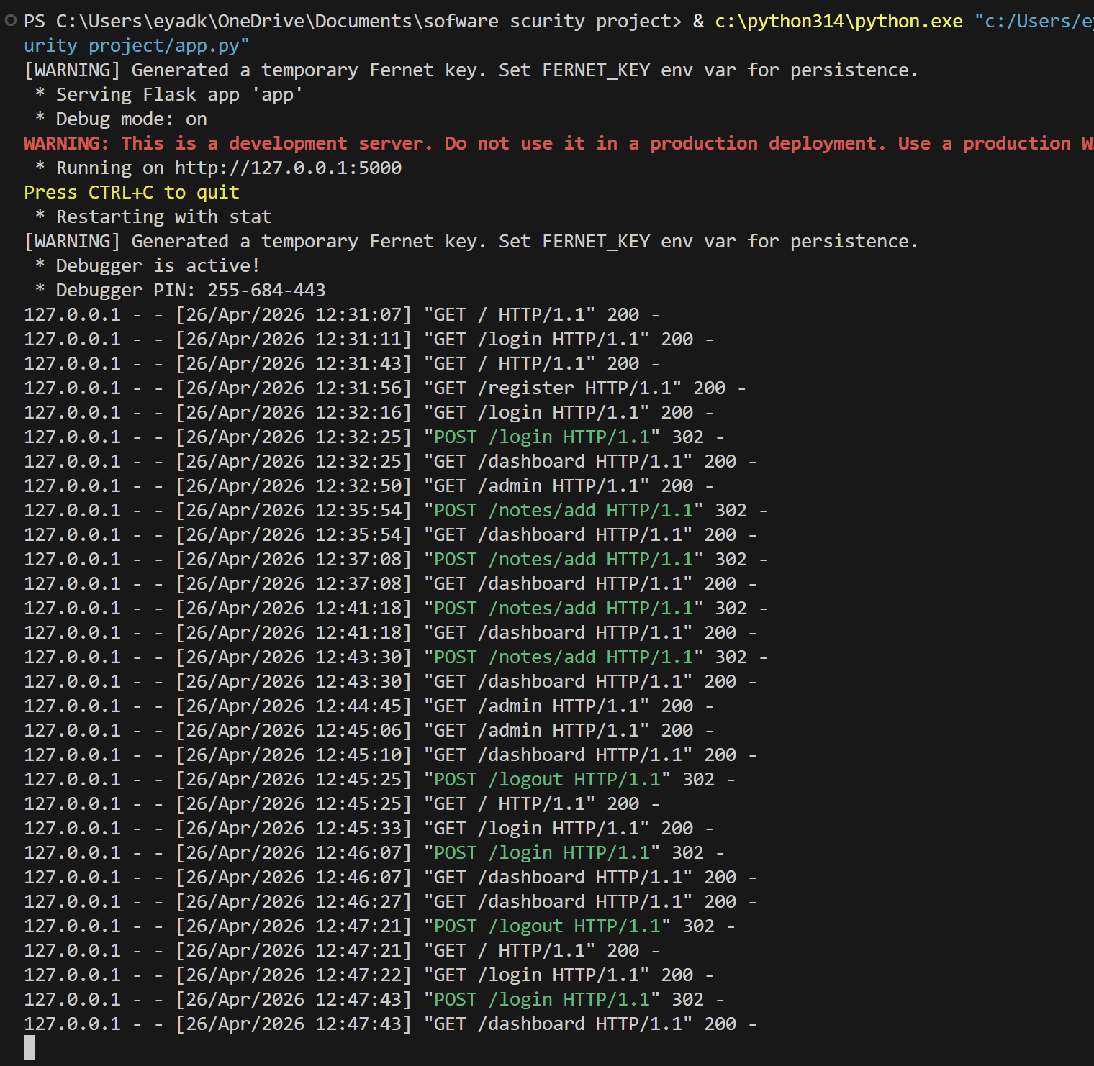
Access restriction
How access is restricted?
Every protected route uses a decorator (@login_required or @admin_required) that checks the session role before the page loads.

Slide 16
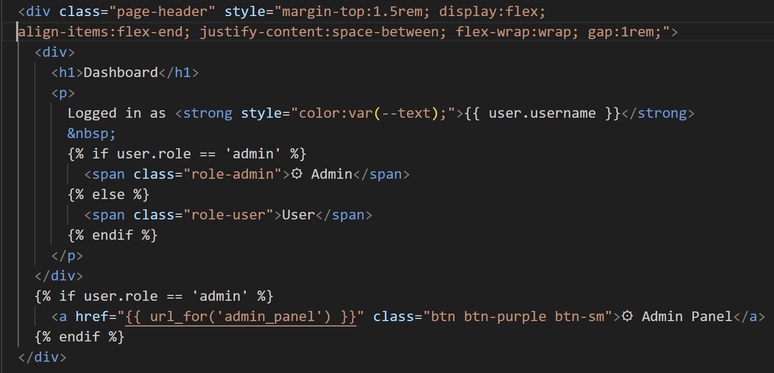
Preventing unauthorized access
How unauthorized access is prevented?
If a non-admin tries to reach /admin, the decorator immediately returns a 403 Access Denied response. If an unauthenticated user tries any protected route, they are redirected to the login page.

Slide 17
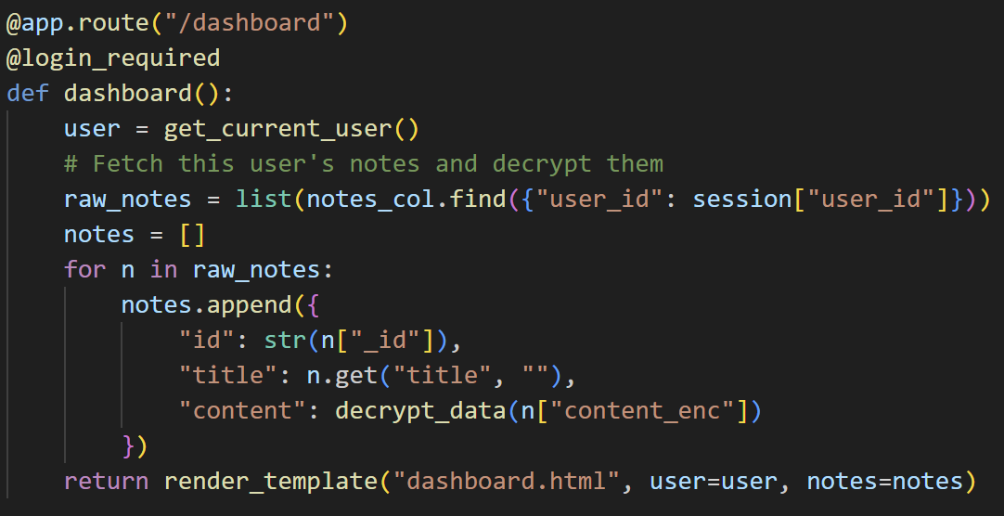
Encryption and decryption
How sensitive data is encrypted Note content is encrypted before being saved to MongoDB and decrypted only when displayed to the authenticated user.
Algorithm used Fernet (from Python’s cryptography library) — symmetric encryption built on AES-128-CBC with HMAC-SHA256 for integrity verification.

Slide 18
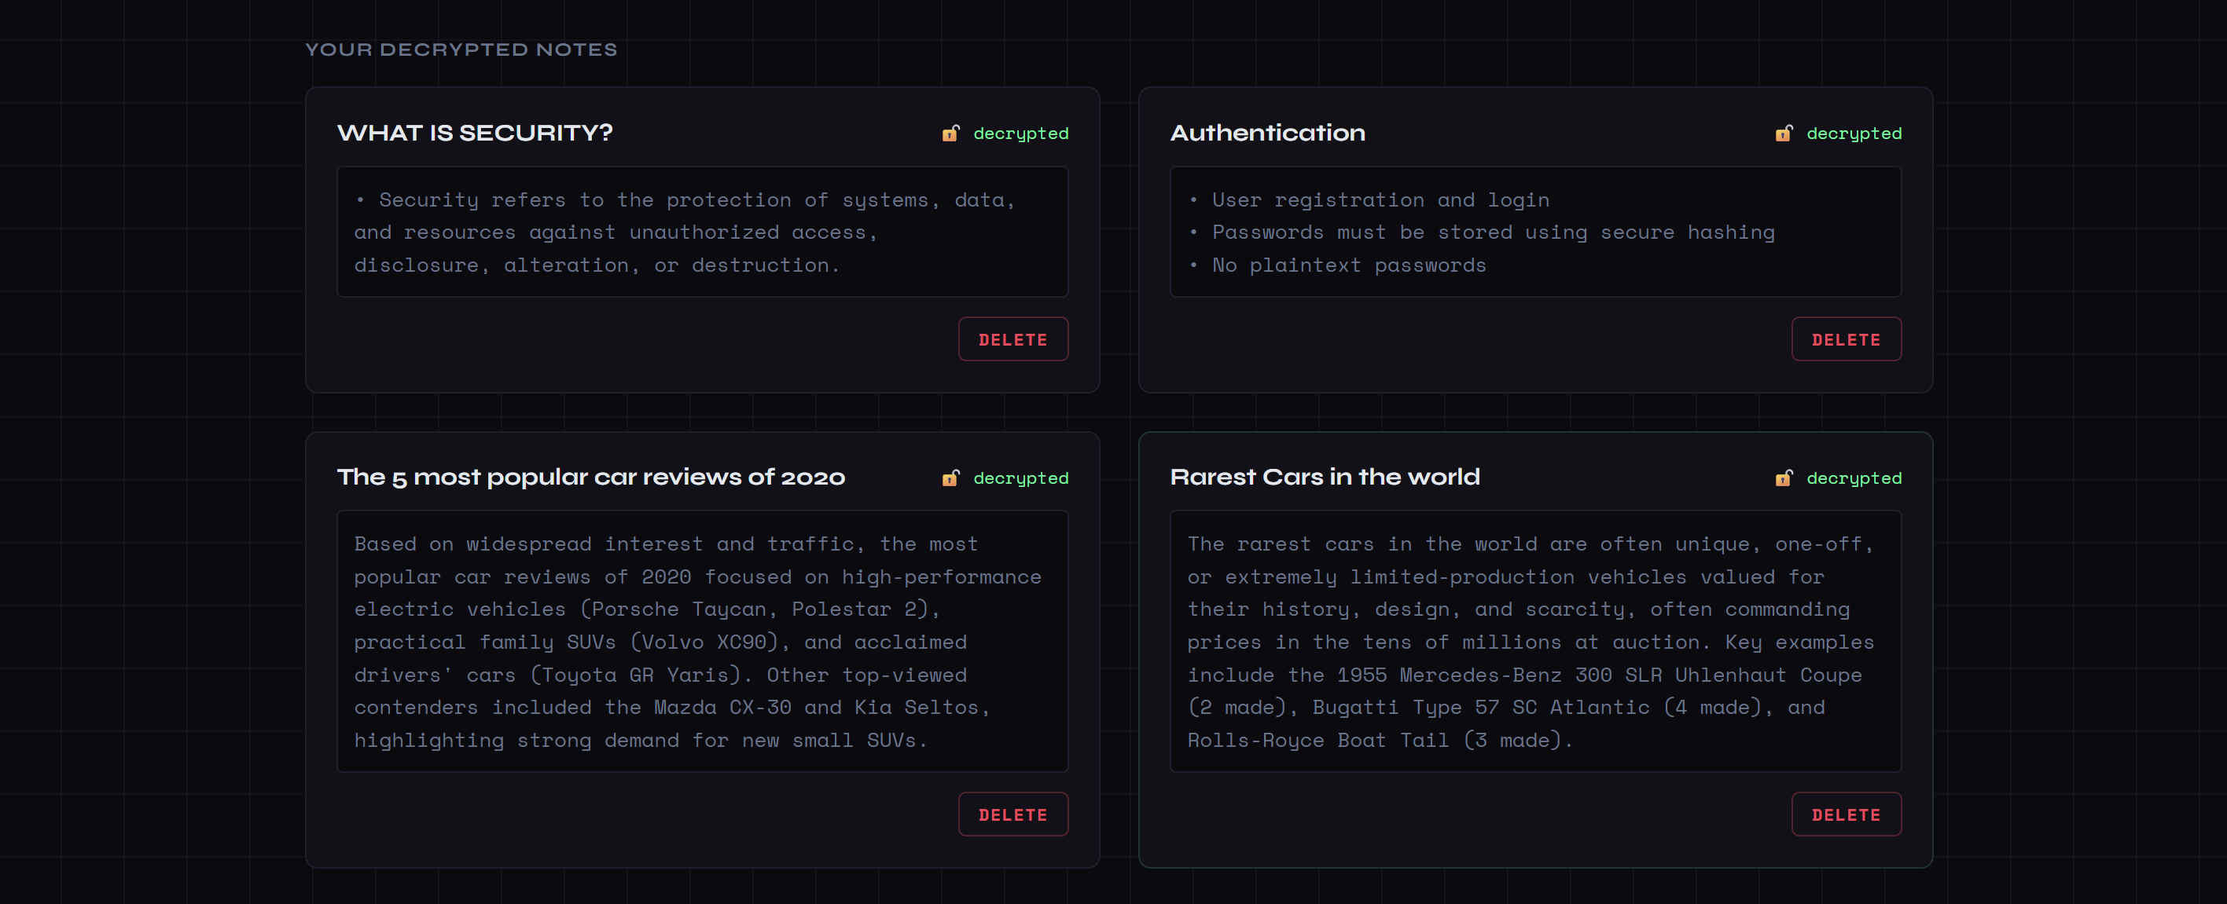
Encryption and decryption
Encryption process cipher.encrypt(note.encode()) → produces ciphertext → stored in MongoDB. Raw text never touches the database.
Decryption process On page load, ciphertext is fetched from MongoDB → cipher.decrypt(ciphertext) → plain text is rendered on screen. Only the app holding the secret key can decrypt.

Slide 19

Thank you

